Slide 1
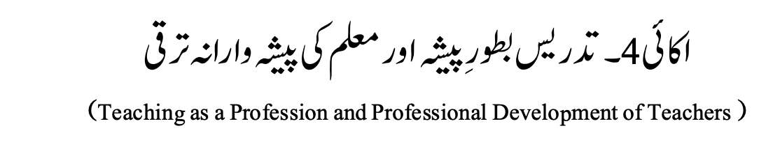

Slide 2
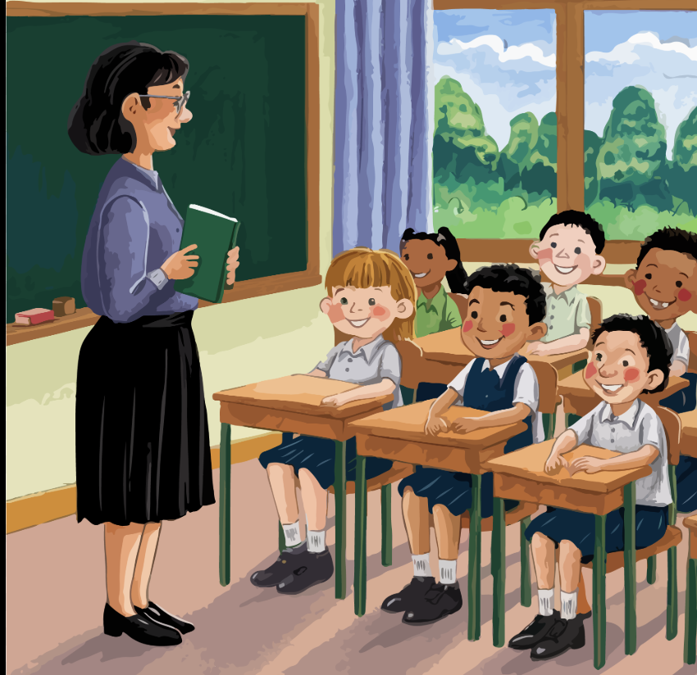

Slide 3
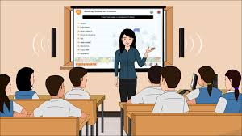
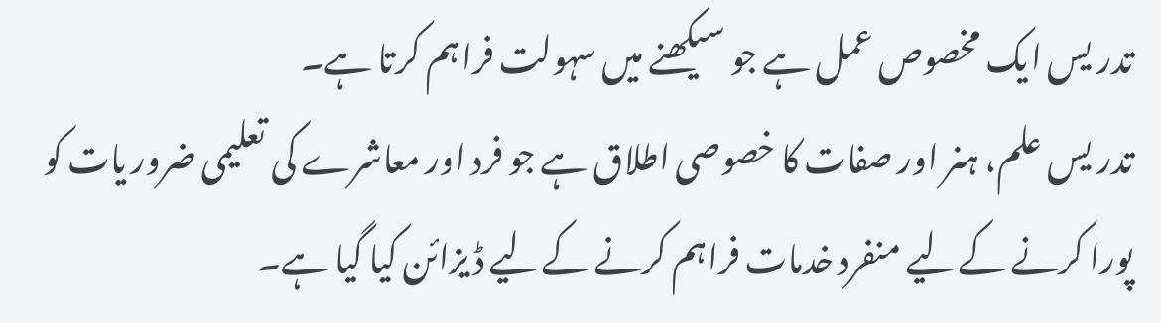
What is Teaching
Teaching is a specified process that facilitates learning.
Teaching is the specialized application of knowledge, skills and attributes designed to provide unique service to meet the Educational needs of individual and society.

Slide 4

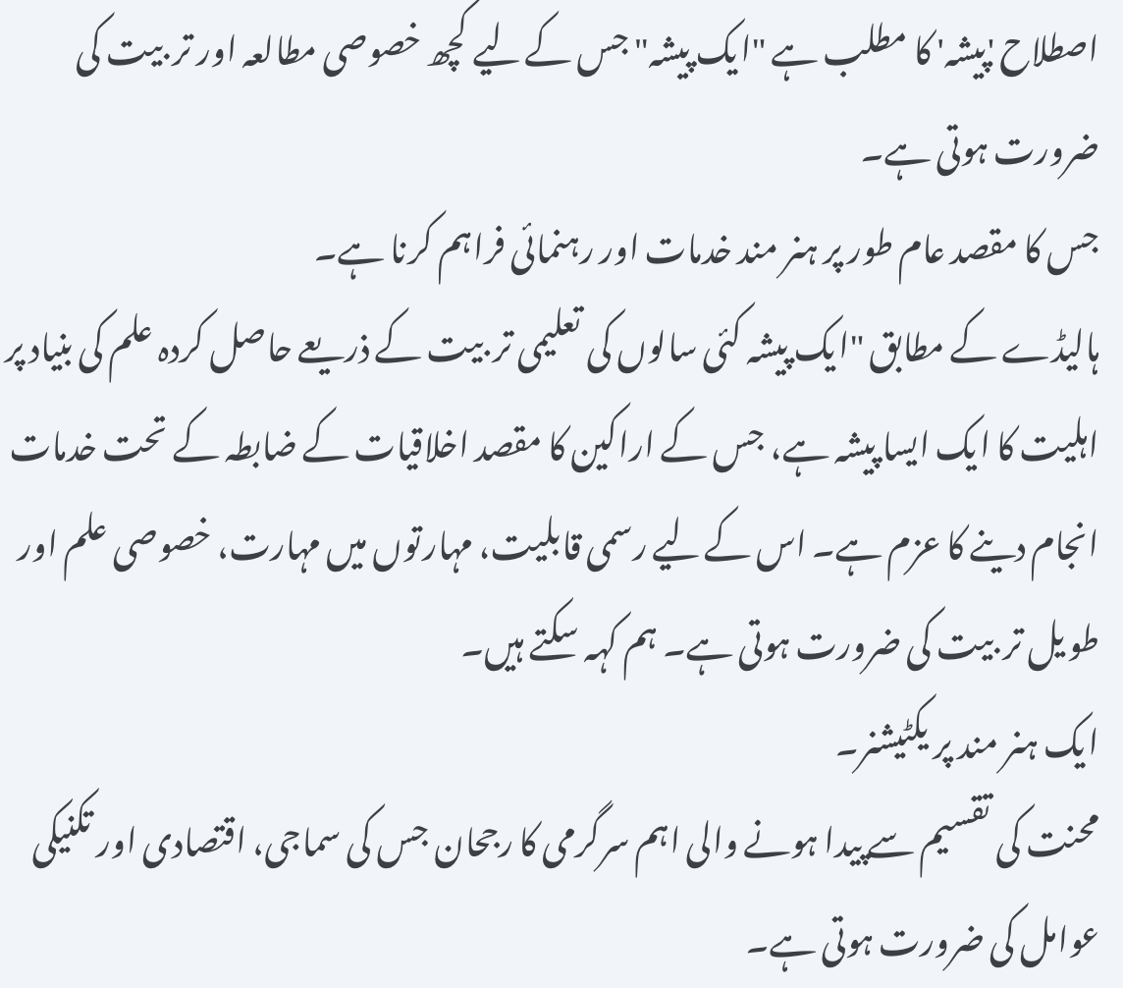
What is Profession
The term 'Profession' stands for “an occupation” which requires some specialized study and training.
Purpose of which is generally to provide skilled services and guidance
According to Halliday “a profession is an occupation with a set of competency based on knowledge acquired through many years of academic training, the goal of its members being a commitment to service guided by a code of ethics. It requires formal qualification, mastery of skills, specialized knowledge and prolonged training. We can say
A skilled practitioner.
Phenomenon of vital activity created by division of labor that social, economical and technological factors require

Slide 5
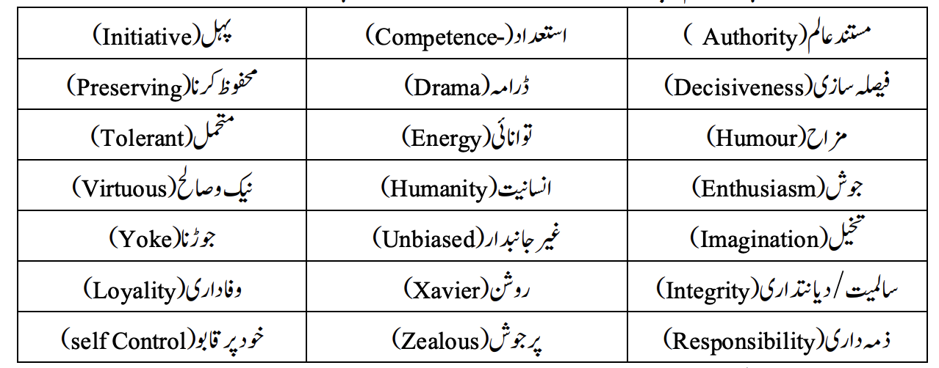

Slide 6
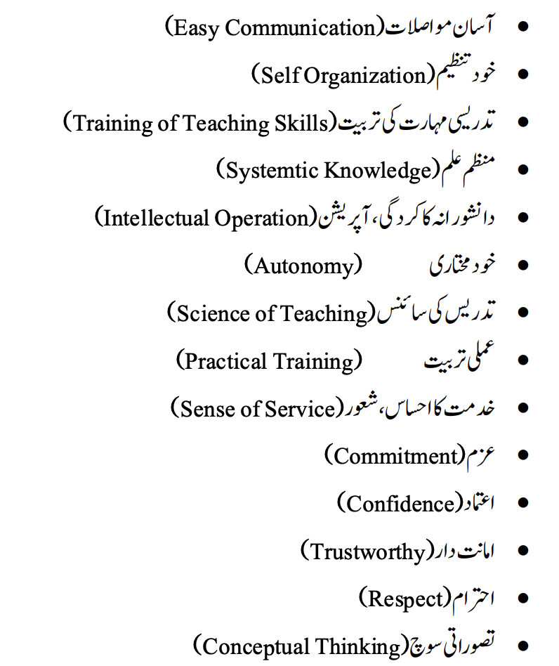
Characteristics of Teaching Profession تدریسی پیشے کی خصوصیات

Slide 7
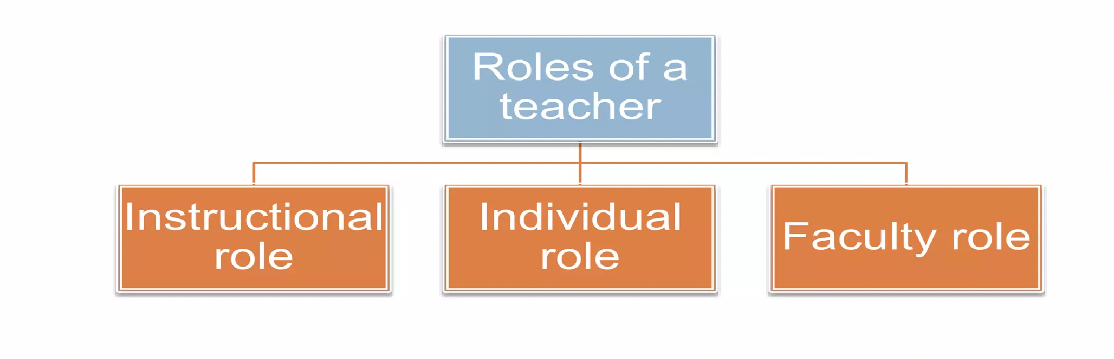
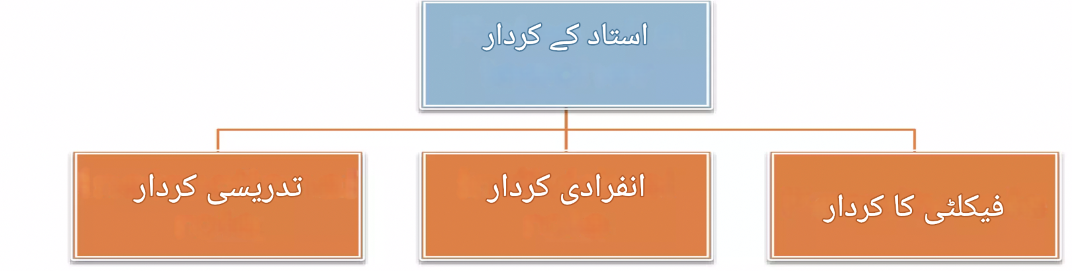

Slide 8

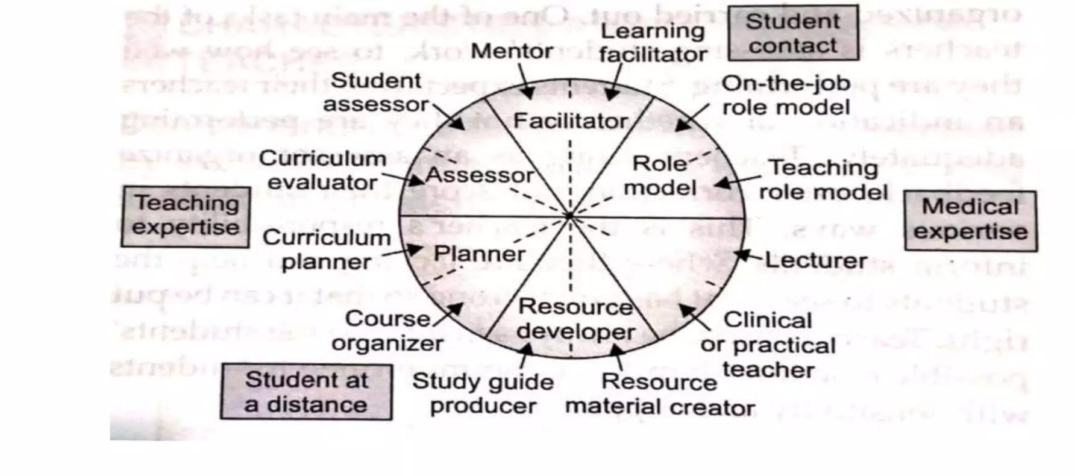
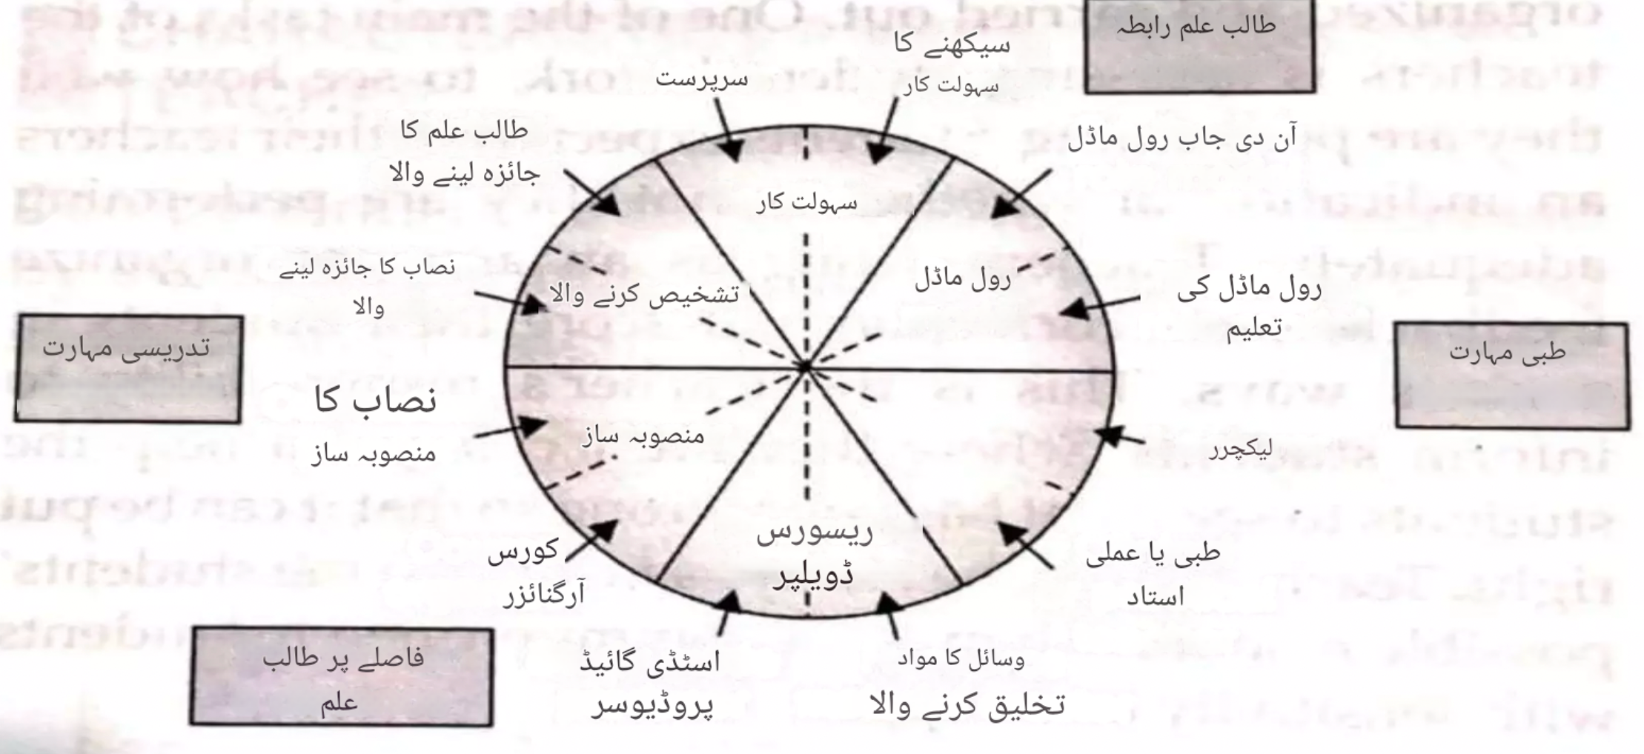

Slide 9
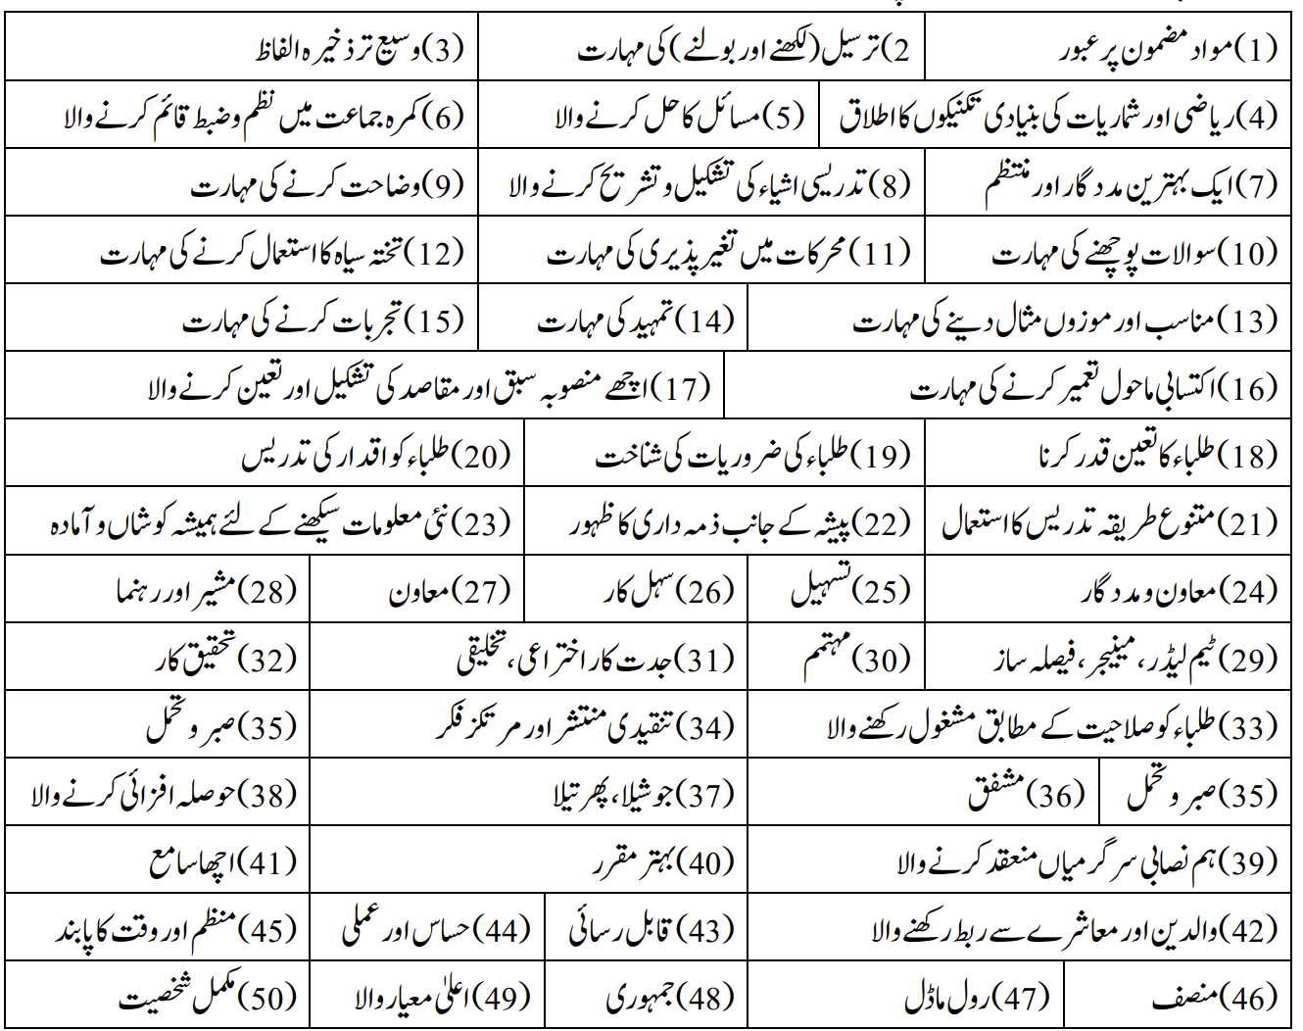
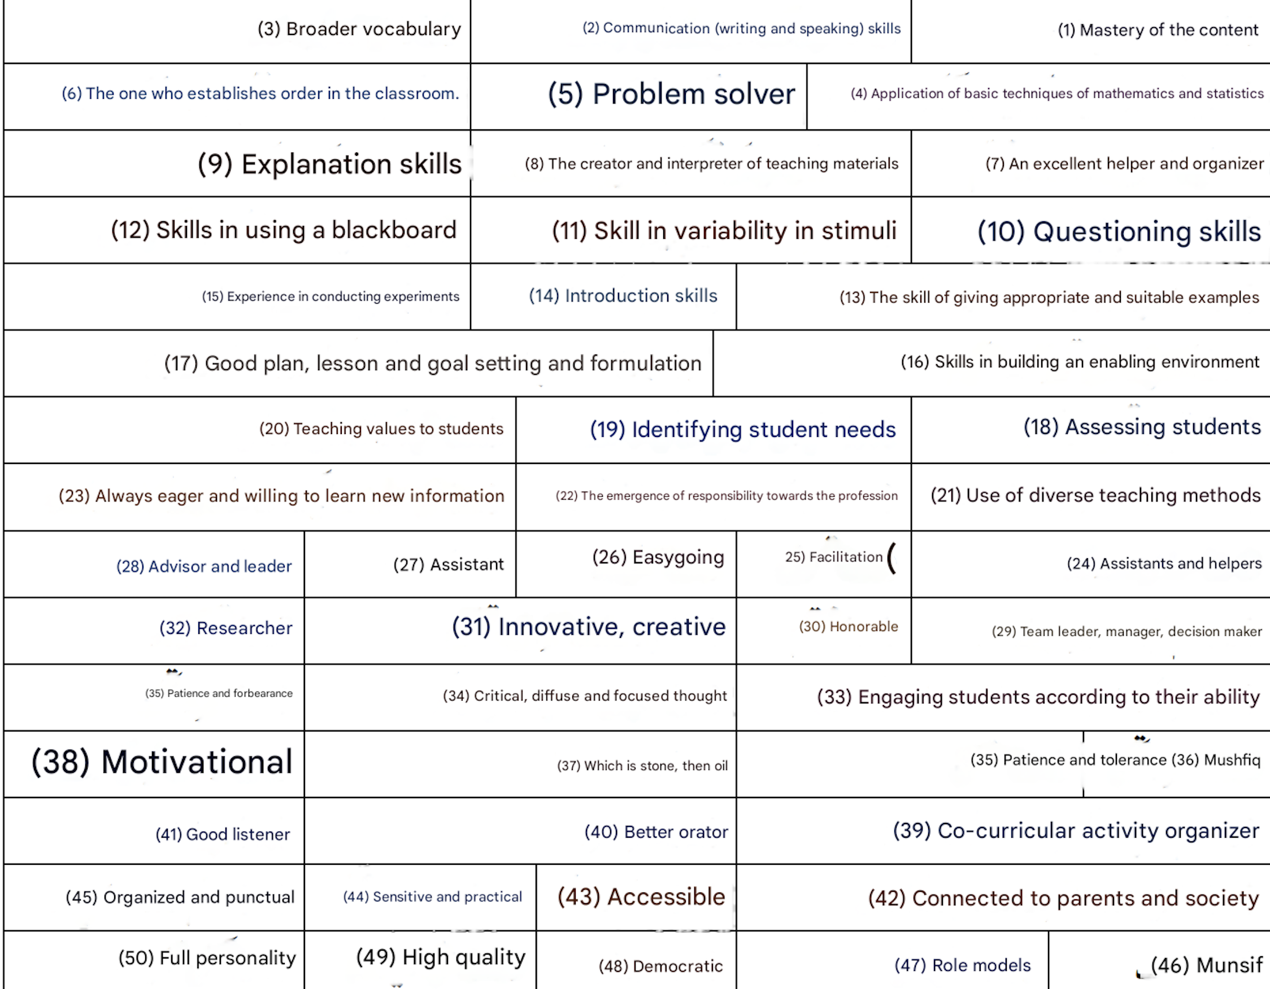

Slide 10
THANK YOU
شکریہ

