Slide 1



Slide 2

Professional ethics for teachers constitute a framework of principles ensuring integrity, fairness, and care in education.
Key obligations include prioritizing student welfare, maintaining impartiality regardless of background, fostering an inclusive environment, acting as positive role models, respecting colleagues, maintaining confidentiality, and engaging in continuous professional development.

Slide 3

Professional Ethics For Teachers Include:
Commitment to Students
Professional Integrity & Competence
Respect for Colleagues & Profession
Responsibility to Society & Parents

Slide 4
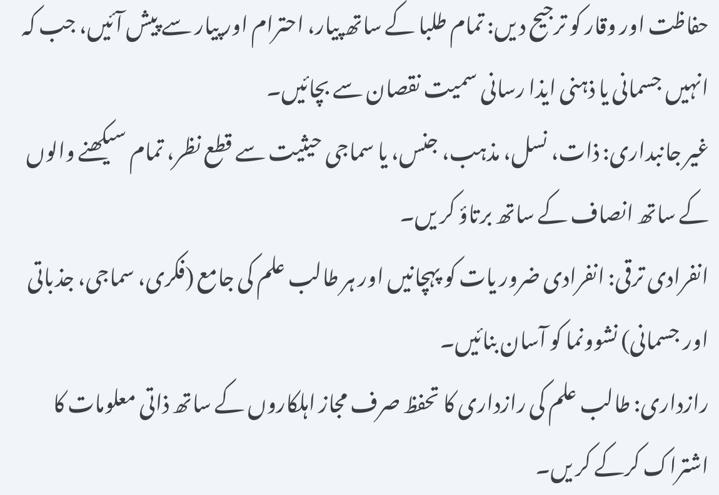
Commitment to Students:
  Prioritize Safety and Dignity: Treat all students with love, respect, and affection, while protecting them from harm, including physical or mental harassment.
  Impartiality: Treat all learners justly, regardless of caste, creed, religion, sex, or social status.
  Individual Development: Recognize individual needs and facilitate the holistic (intellectual, social, emotional, and physical) development of each student.
  Confidentiality: Protect student privacy by only sharing personal information with authorized personnel.

Slide 5

Professional Integrity & Competence
Continuous Learning: Remain up-to-date with academic and pedagogical developments.
Honesty & Conduct: Maintain high standards of honesty, avoiding unprofessional behavior or private tuition for gain.
Accountability: Take responsibility for pedagogical decisions and uphold constitutional values.

Slide 6

Respect for Colleagues & Profession:
Collaboration: Foster a culture of teamwork and respectful, constructive dialogue with fellow teachers.
Professional Respect: Avoid making unsubstantiated or derogatory comments about colleagues.

Slide 7

Responsibility to Society & Parents:
Partnership: Build positive relationships with parents and the community to support student growth.
Role Model: Model democratic values, patriotism, and a high standard of conduct.

Slide 8
THANK YOU

