Slide 2
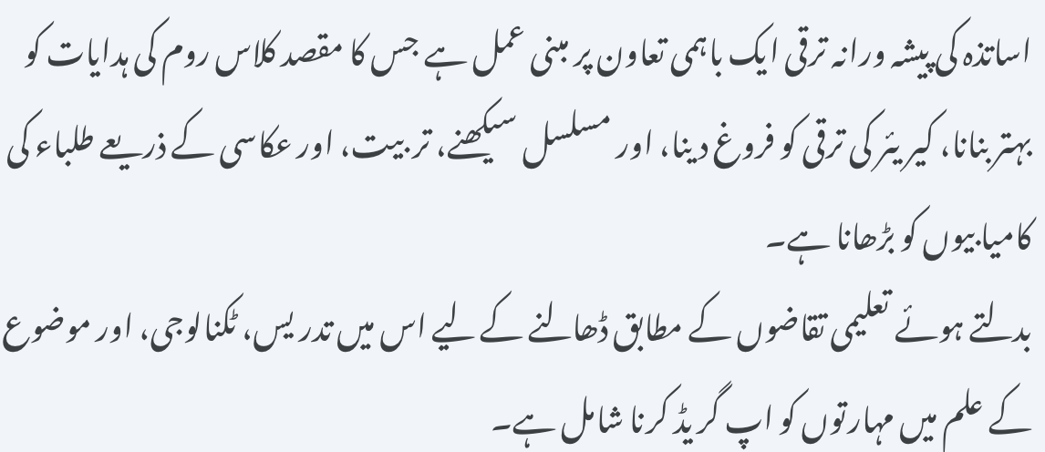
Teacher professional development is a collaborative process aimed at improving classroom instruction, fostering career growth, and raising student achievement through continuous learning, training, and reflection.
It involves upgrading skills in pedagogy, technology, and subject knowledge to adapt to changing educational demands.

Slide 3
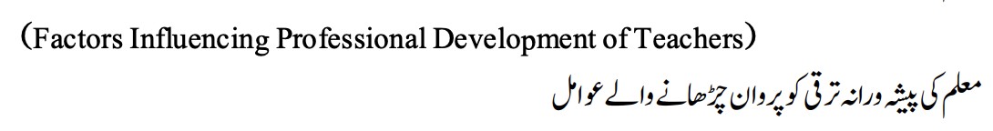
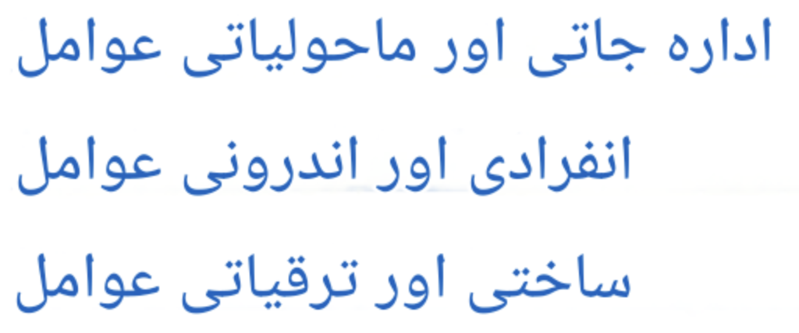
Institutional & Environmental Factors
Individual & Internal Factors
Structural & Developmental Factors

Slide 4

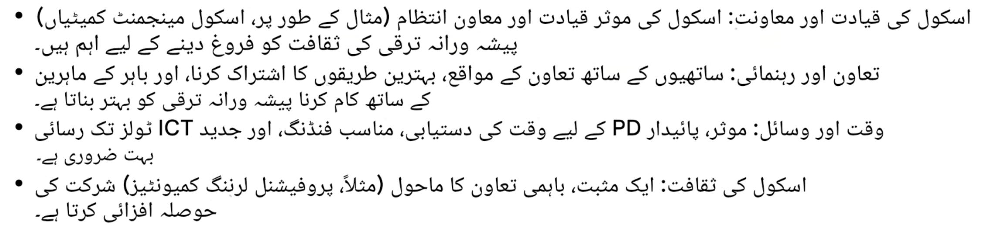
Institutional & Environmental Factors
  School Leadership & Support: Effective school leadership and supportive management (e.g., School Management Committees) are critical to fostering a culture of professional growth.
  Collaboration & Mentorship: Opportunities for collaboration with peers, sharing best practices, and working with outside experts improve professional growth.
  Time & Resources: Availability of time, proper funding, and access to modern ICT tools are crucial for effective, sustained PD.
  School Culture: A positive, collaborative environment (e.g., Professional Learning Communities) encourages participation.

Slide 5

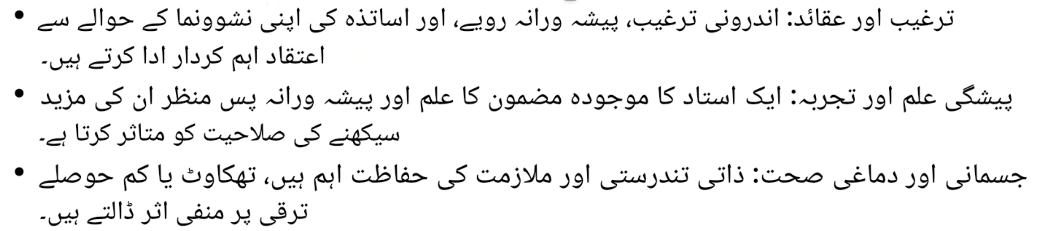
Individual & Internal Factors
  Motivation & Beliefs: Intrinsic motivation, professional attitudes, and teacher beliefs regarding their own development play a major role.
  Prior Knowledge & Experience: A teacher's existing subject knowledge and professional background influence their capacity for further learning.
  Physical & Mental Health: Personal wellbeing and job security are significant, with fatigue or low morale negatively impacting development.

Slide 6

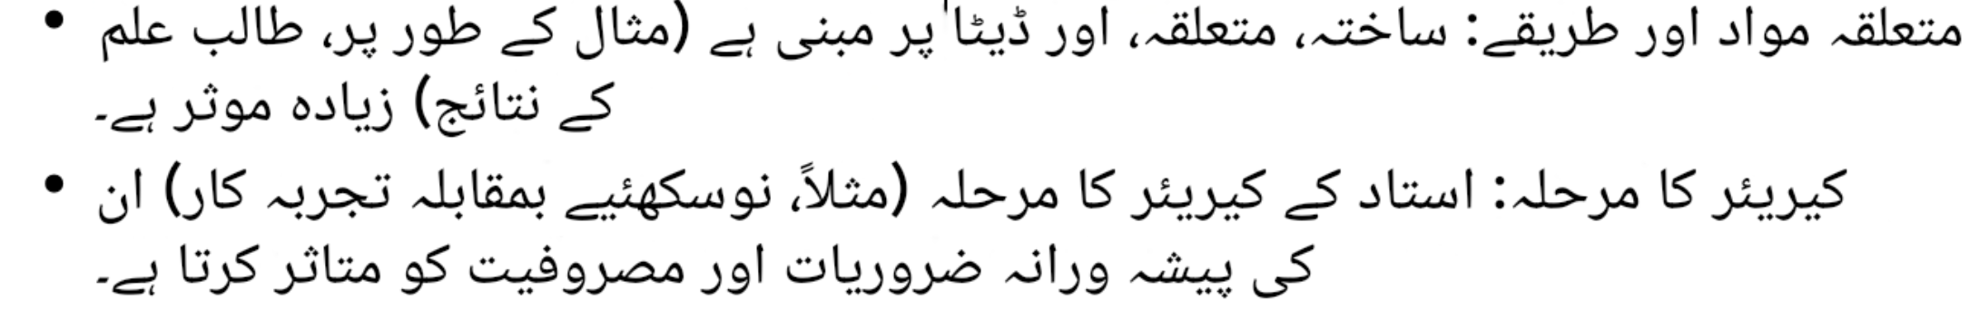
Structural & Developmental Factors
  Relevant Content & Methods: is structured, relevant, and based on data (e.g., student results) is more effective.
  Career Phase: The stage of a teacher's career (e.g., novice vs. experienced) affects their professional needs and engagement.

Slide 7

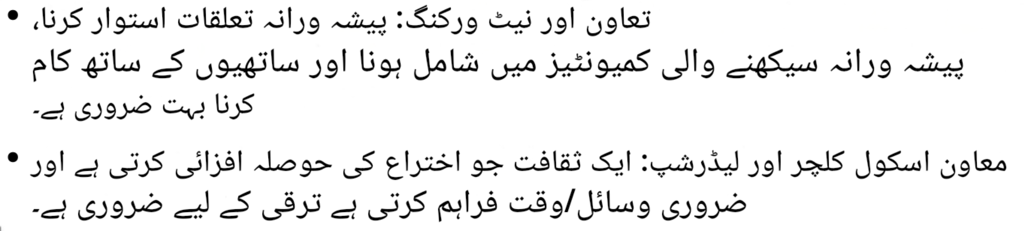
Factors Fostering Teachers Professional Development
Collaboration & Networking: Building professional relationships, engaging in professional learning communities and working with colleagues are crucial.
Supportive School Culture & Leadership: A culture that encourages innovation and provides necessary resources/time is essential for growth.

Slide 8
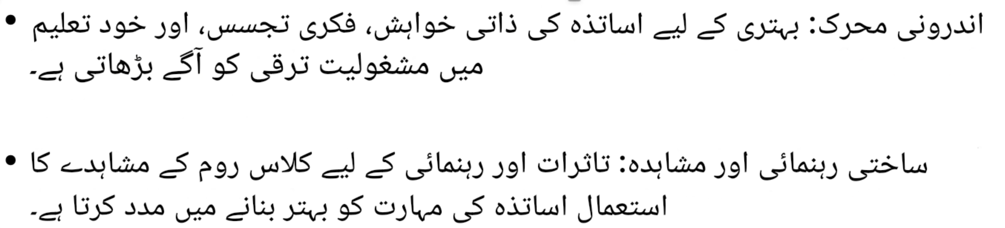
Intrinsic Motivation: Teachers' personal desire for improvement, intellectual curiosity, and engagement in self-education drives development.
Structured Mentoring & Observation: Using classroom observation for feedback and mentoring helps teachers refine skills.

Slide 9
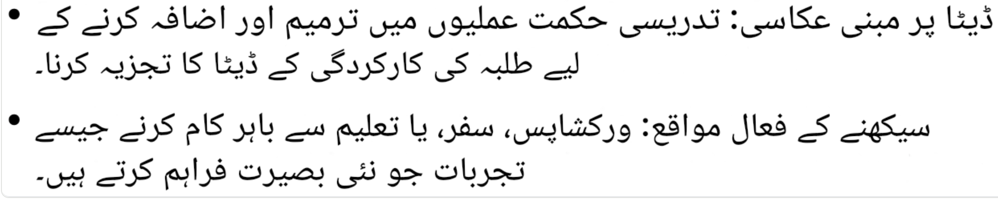
Data-Driven Reflection: Analyzing student performance data to modify and enhance instructional strategies.
Active Learning Opportunities: Experiences like workshops, traveling, or working outside education that provide new insights.

Slide 10
THANK YOU

