Slide 1

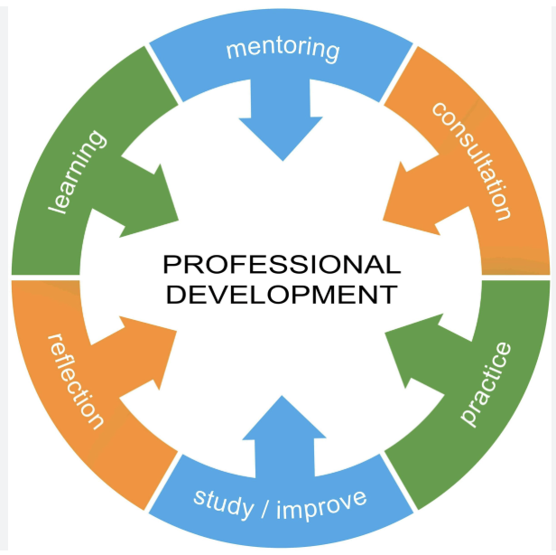

Slide 2


Teachers Professional Development is a means by which teachers can be provided with broad innovative and crucial information.
Effective Teachers Development Program begins with an understanding of their needs, environment and nature of institution.
They employ variety of approaches and techniques that enhances teaching, provide the support, engage in school leadership and ensure the use of assessment tools for impact.
All these programs engage teachers as active learners.

Slide 3

Self Directed Development
Collaborative & Peer-Based Learning
Reflective Practices
Action Research & Inquiry
Structured Training
Job-Embedded & Digital Learning

Slide 4

Self Directed Development: Teachers take initiative through self-evaluation, maintaining portfolios, reading literature, attending workshops, and action research.

Slide 5

Collaborative & Peer-Based Learning: Peer coaching, mentoring, lesson study, and professional learning communities (PLCs) allow teachers to learn from each other.

Slide 6

Reflective Practices: Journal writing, portfolios, and self-evaluation help teachers analyze their own teaching methods.

Slide 7

Action Research & Inquiry: Teachers systematically investigate classroom challenges to implement evidence-based solutions.

Slide 8

Structured Training: Workshops, seminars, and conferences focused on new pedagogical skills and technology integration.

Slide 9

Job-Embedded & Digital Learning: Utilizing MOOCs (e.g., SWAYAM), webinars, and online content for flexible, ongoing training.

Slide 10

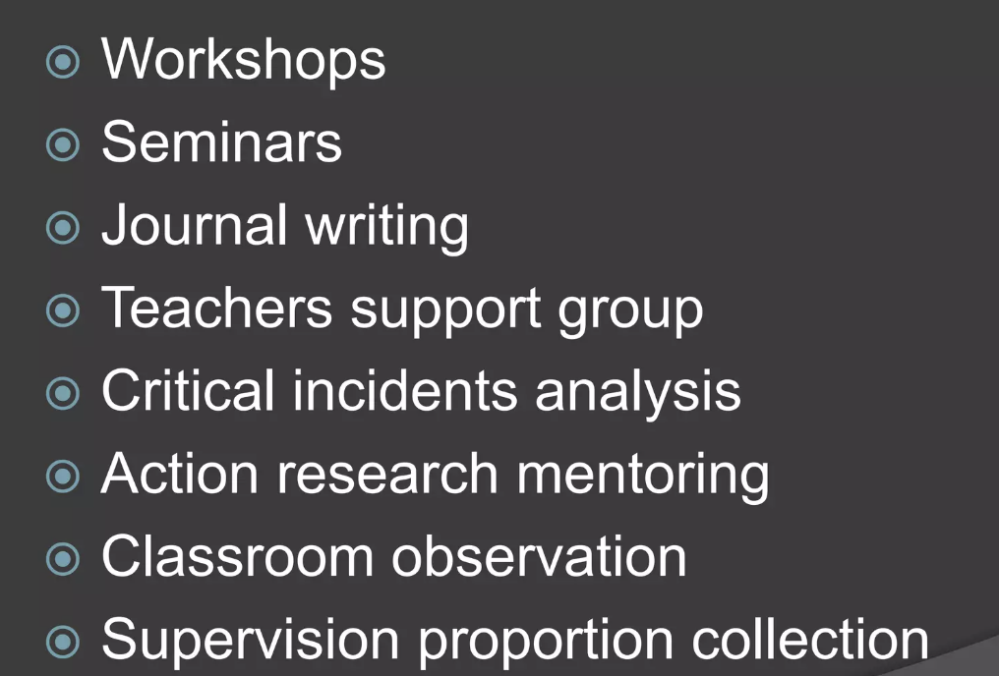

Some Other Approaches are as follows:

Slide 11
THANK YOU

